Slide 1
GDPR Compliant Public Blockchain using AI Smart Contract
MSDS 7349 : Data|network Security
By Andy Ho , An Nguyen, Jodi Pafford

Slide 2

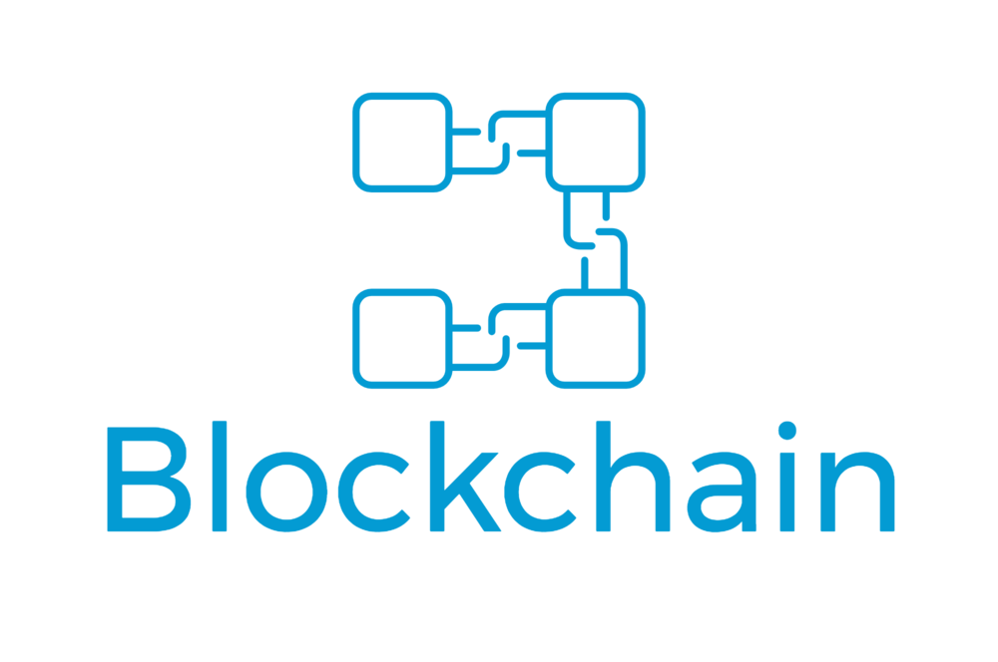

EXECUTIVE SUMMARY: A Solid Solution for the Digital Era
The fourth industrial revolution (4IR) will usher in an era of complete dependency on technology for our daily lives. The technology will be fueled by personal data. As security threats loom, users should have the right to control their digital identity, history, or information while getting compensated by entities who require their data. And entities should be held accountable when this personal data is at use.
Our research dives into data protection, technology, and compensation:

Slide 3

PROBLEM: Protecting Personal Information is Costly But Required
€20 million, or four percent of the violator's annual revenue
GDPR compliance is time-consuming and costly but is necessary. As governments look to protect their citizen’s personal data and people become the central product of companies and technology, what new/emerging technology can be developed to provide security and decentralization to support a digital society?

Slide 4
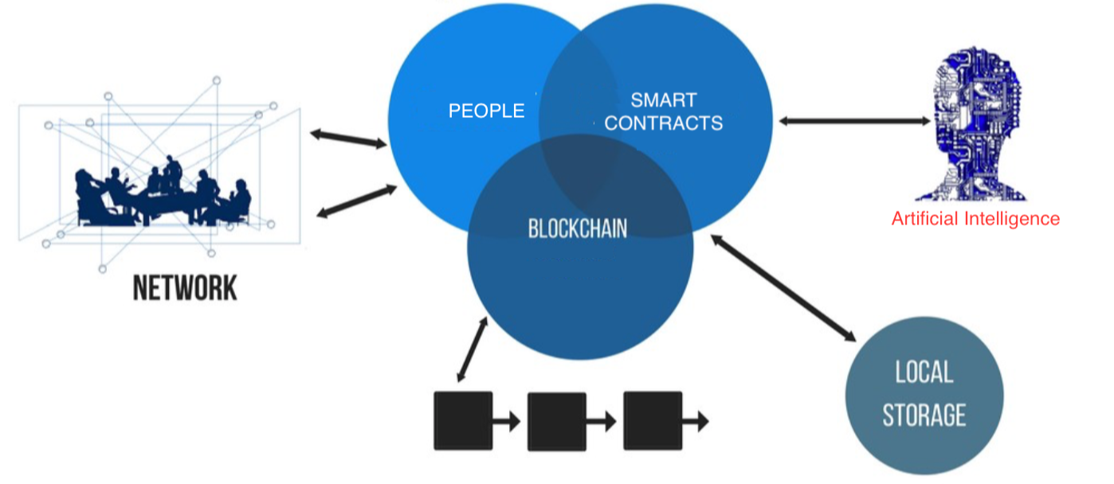
SOLUTION:
Blockchain technology is a revolutionary breakthrough but in its current form, is not GDPR compliant. Our novel approach is to leverage a public blockchain using AI smart contracts to fully unlock the security and decentralization features of blockchain technology while being GDPR compliant.

Slide 5
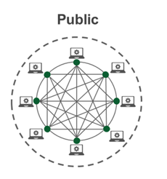
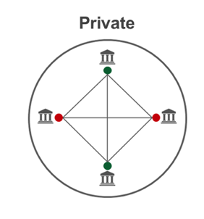
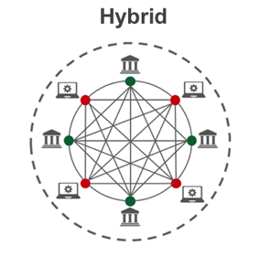
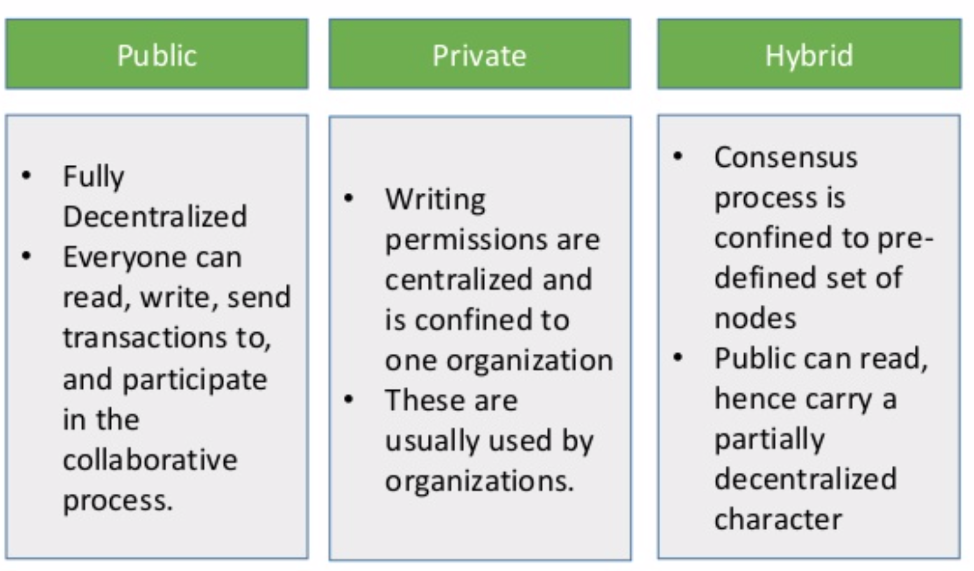
CURRENT RESEARCH: Hybrid Blockchain Marginalizes
Majority of current solutions focus on a hybrid/permissible blockchain where organizations store personal information on a private blockchain while linking references on the public blockchain. This takes away from the security and decentralization of blockchain technology.

Slide 6
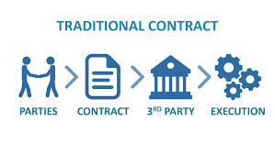
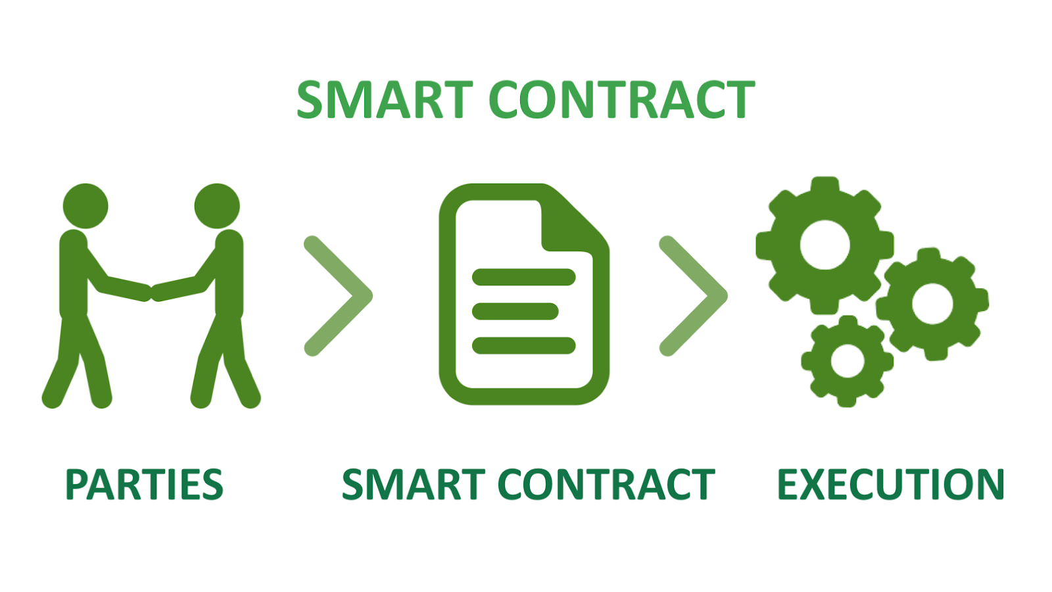
NOVEL APPROACH: Artificial Intelligence Smart Contracts is the KEY
Smart contracts, contrary to traditional contracts, convert the agreement statements into a computer program with code. A smart contract not only defines the rules and penalties related to an agreement in the same way that a traditional contract does, but it can also automatically enforce those obligations.
AI adds another dimension to current Smart Contracts by providing an additional layer of security and control by providing users classification/regression scores on entities risks, liabilities, and trustworthiness.

Slide 7
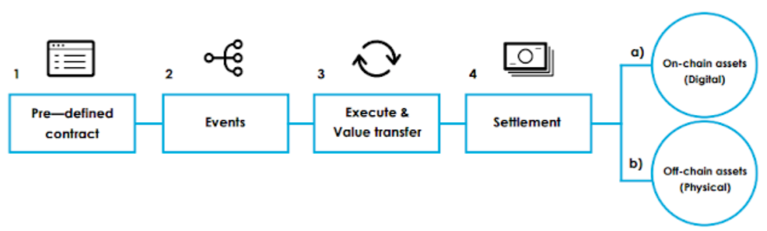
SMART CONTRACT WORKFLOW: Conceptual Design With Real-World Application
Terms are set by individual such as:
Tiers of Data
Payment Amounts per Tier
Conditions for execution
Entity’s requesting data risk score
Artificial Intelligence works in tantum with Smart Contract
Event triggers contract execution
Event can refer to:
Information request
Edit or Deletion Request by User
Terms of contract dictate movement of value
Users and Entities will have cryptocurrency wallets to credit or debit based on transaction
This will occur automatically without 3rd party intervention
Possible to move off-chain assets but rare.

Slide 8
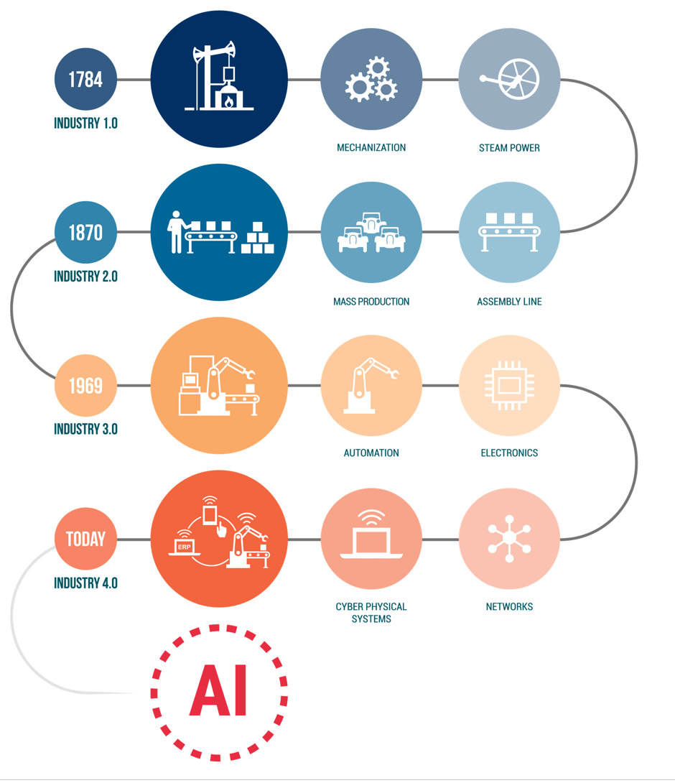
CONCLUSION: More Research Required
The revolution is just beginning…more research and novel approaches will arise with more sophistication in blockchain, artificial intelligence, network infrastructure, and overall technology improvements.
One thing is certain, the security and protection of personal information (and company intellectual property) will continue to be valued by adversaries and foreign states to illegally obtain and misuse.

Slide 9
QUESTIONS?
Andy Ho
atho@smu.edu
An Nguyen
anguyen2@smu.edu
Jodi Pafford
jpafford@smu.edu

Slide 10
REFERENCES
Blockchain
https://www.slideshare.net/narnoli/blockchain-basics-76836475
https://blockchainhub.net/blockchains-and-distributed-ledger-technologies-in-general/
https://medium.com/applicature/utilization-of-distributed-technologies-for-custom-solutions-public-private-and-hybrid-570a1e14852
GDPR
https://www.bonline.com/blog/what-is-gdpr/
Smart Contracts
https://cialforcdlc.blogspot.com/2018/11/asmart-contract-is-computer-code.html
https://hackernoon.com/ai-smart-contracts-the-past-present-and-future-625d3416807b
Artificial Intelligence
https://www.cbinsights.com/research/jobs-automation-artificial-intelligence-risk/

